Slide 1

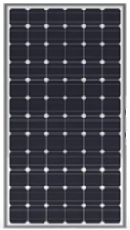

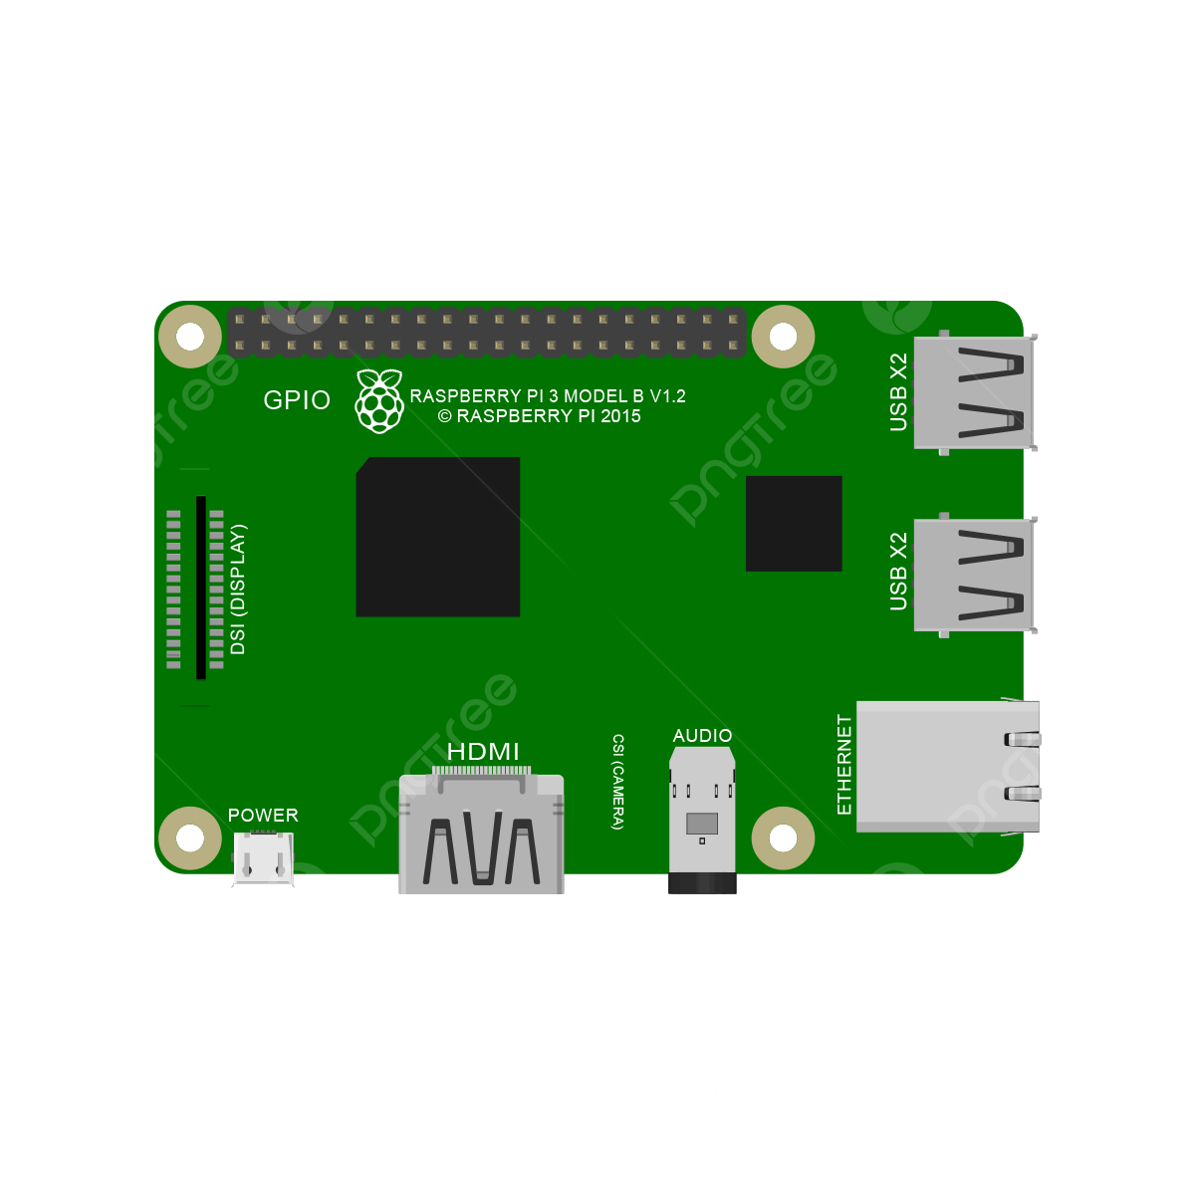






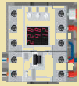

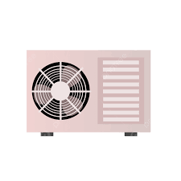
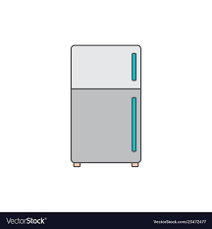



Energy Management System
Virtual
Power
Plant
Home Assistant
Micro
Inverter
3
5
Home Automation Platform
2
4
1
Hybrid
BMS
Notes:
HomeGrid_Standardization_Initiative, 2024-08-28

Slide 2
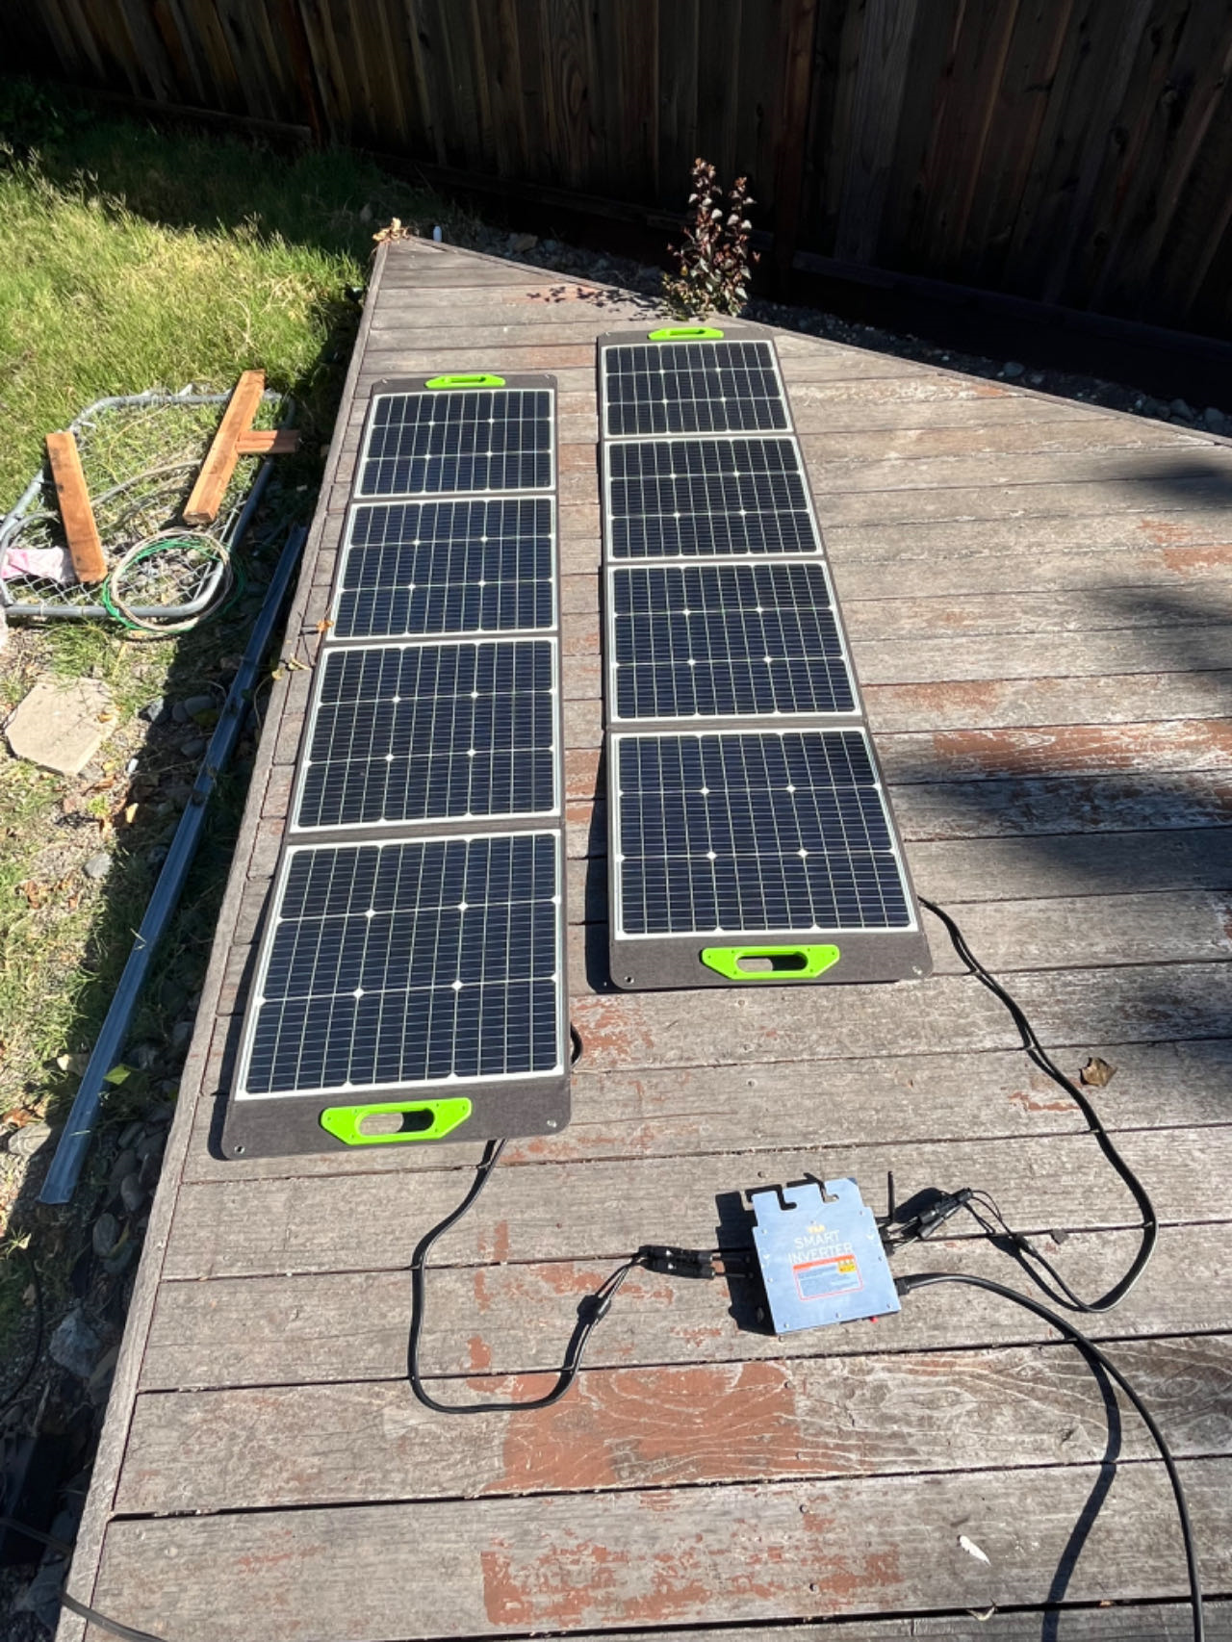
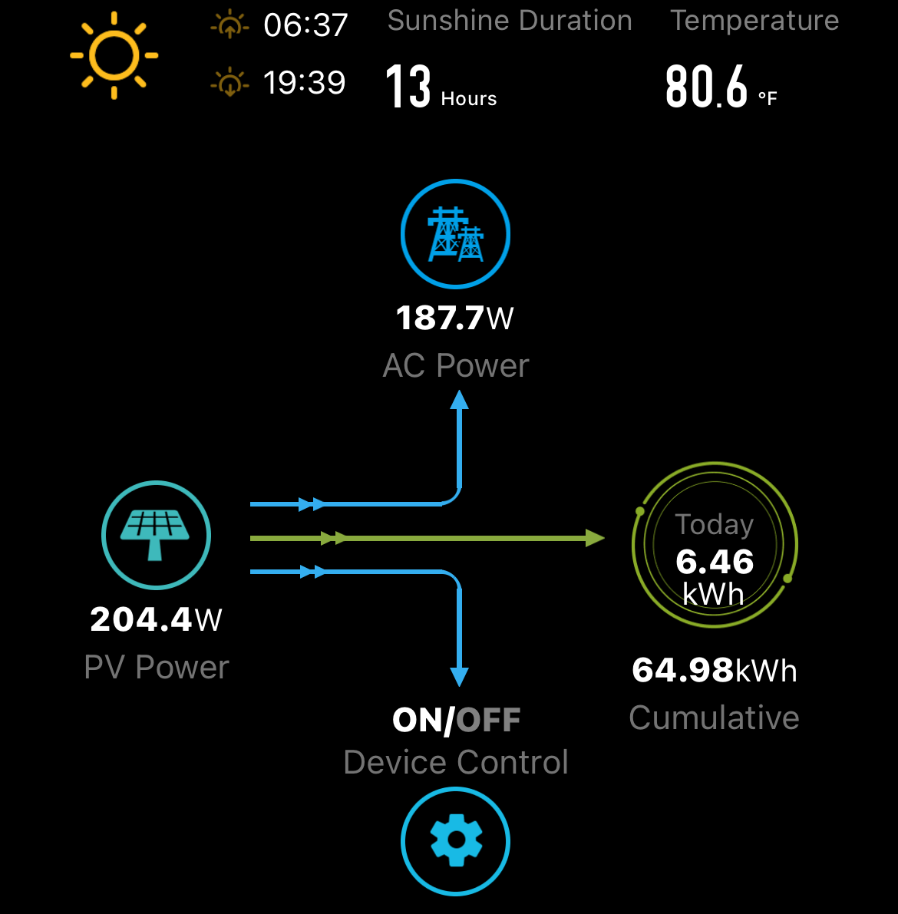
1
Micro
Inverter
Hybrid
BMS
Notes:
HomeGrid_Standardization_Initiative, 2024-08-28

Slide 3
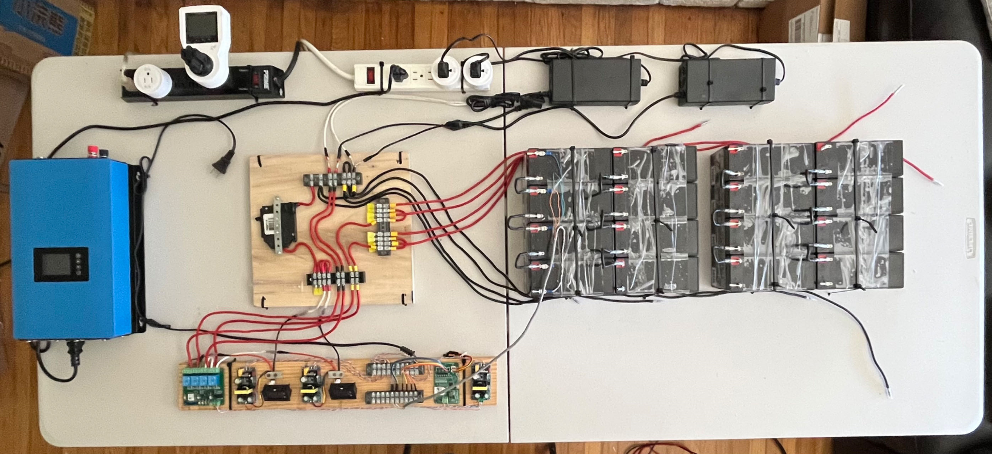
Energy Management System
Home Assistant
Micro
Inverter
Home Automation Platform
2
Hybrid
BMS
Notes:
HomeGrid_Standardization_Initiative, 2024-08-28

Slide 4
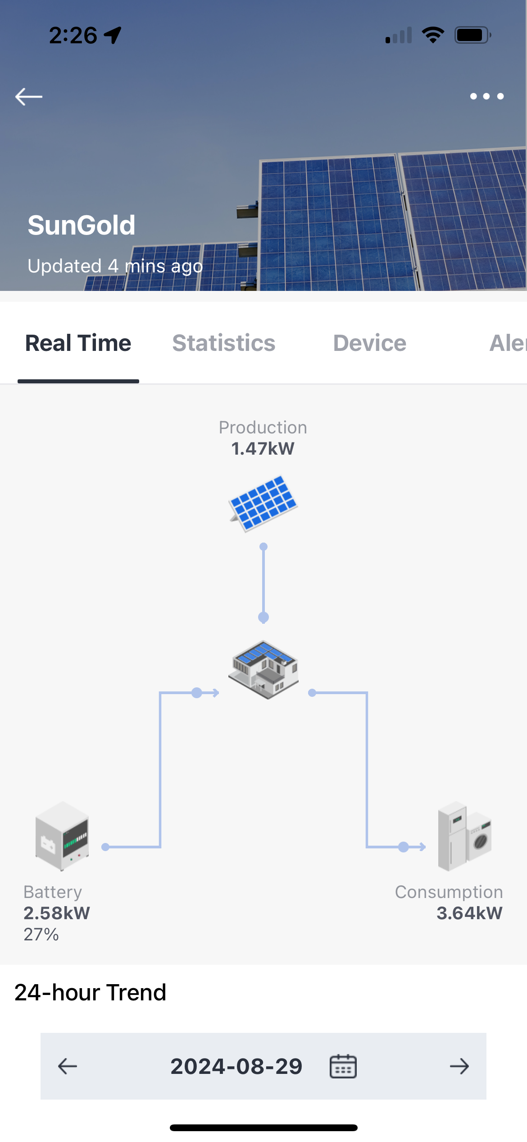
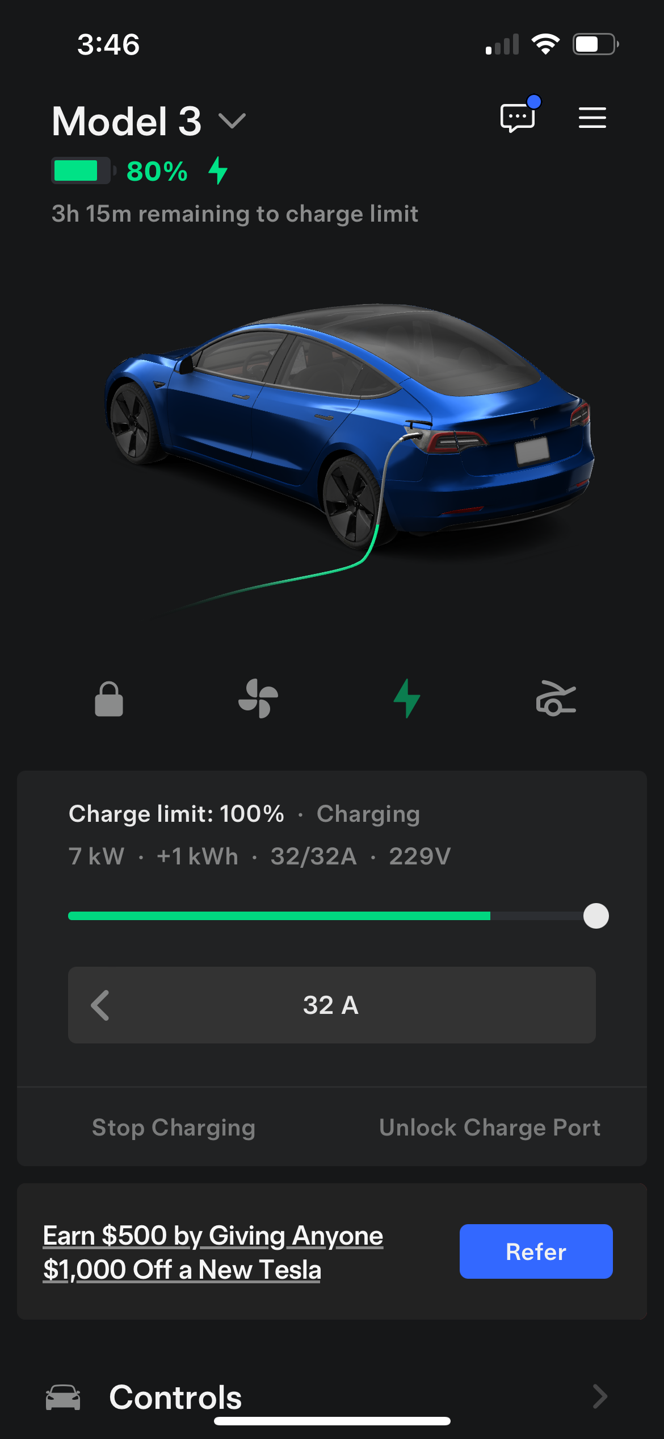
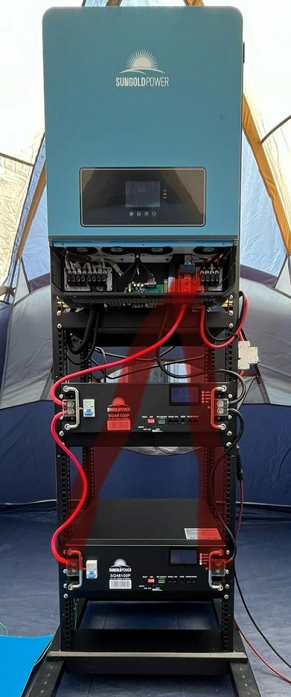
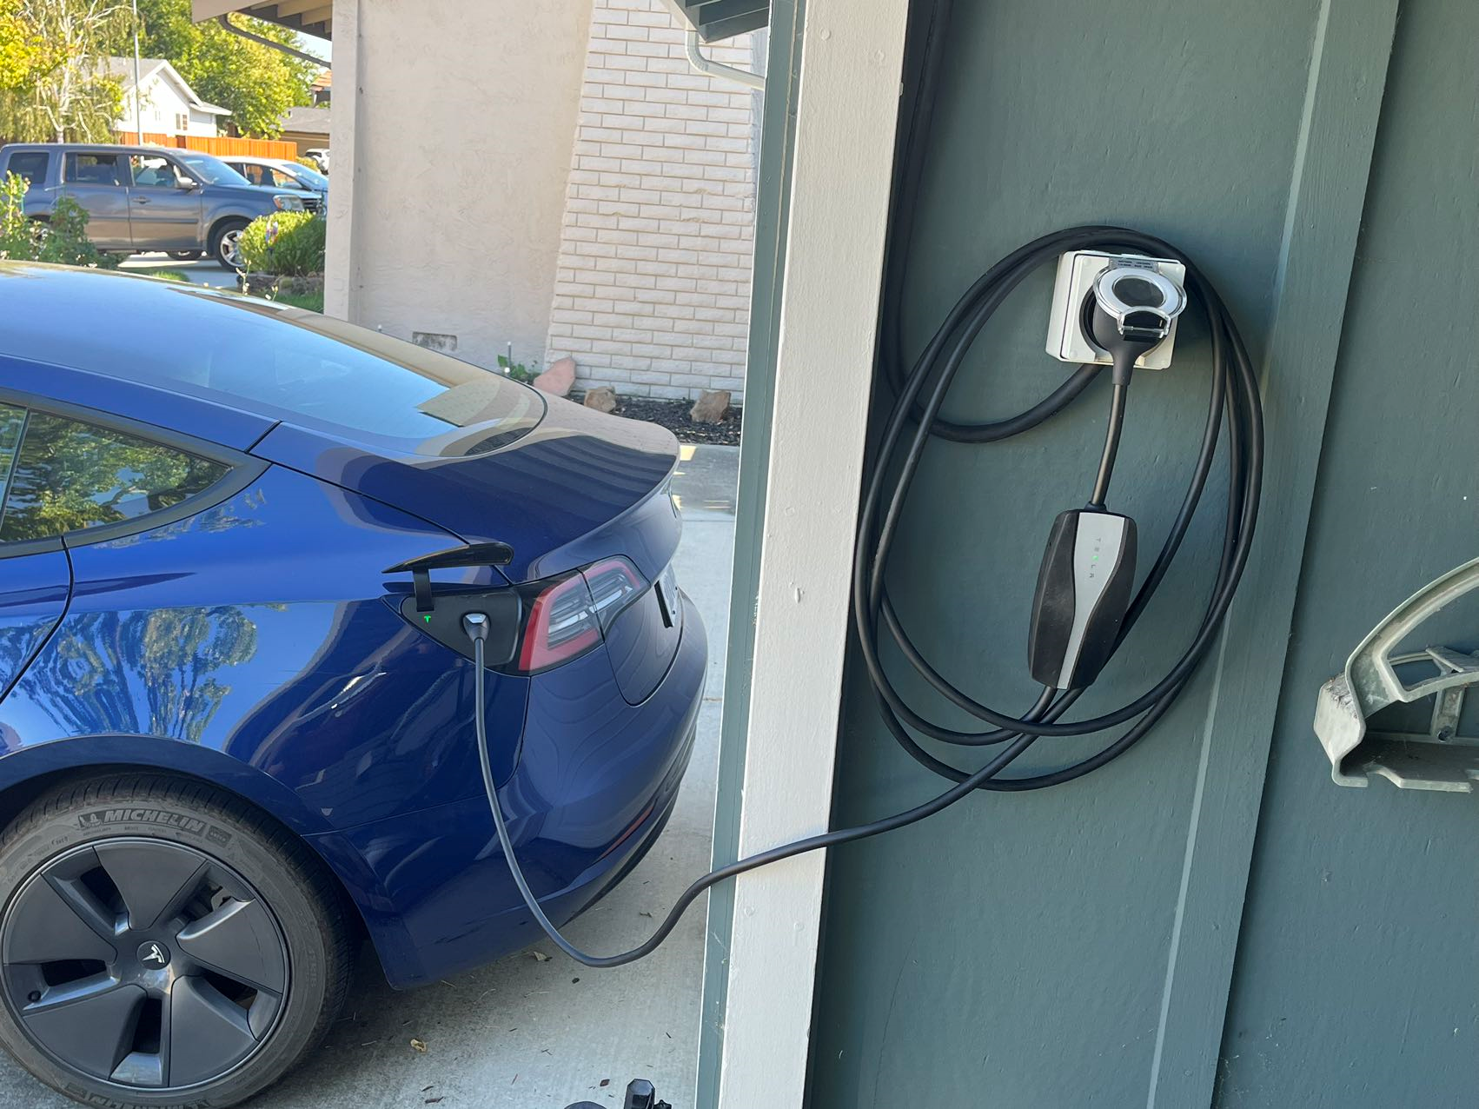
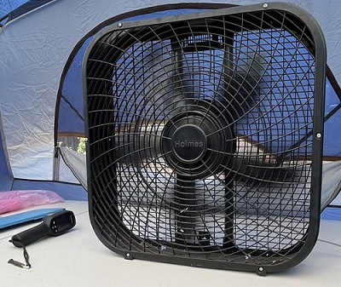
Micro
Inverter
3
Hybrid
BMS
Notes:
HomeGrid_Standardization_Initiative, 2024-08-28

Slide 5
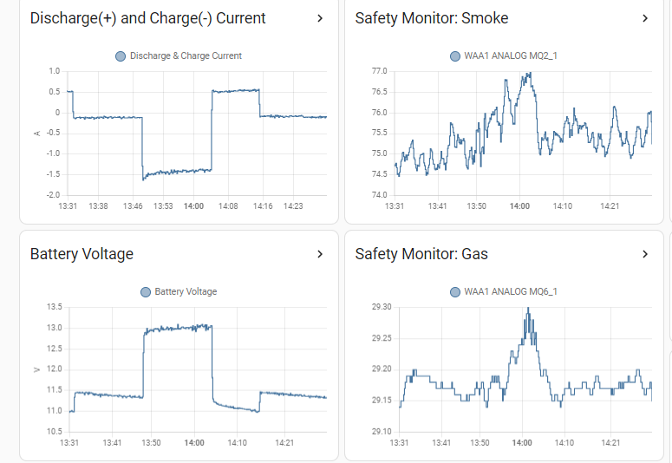
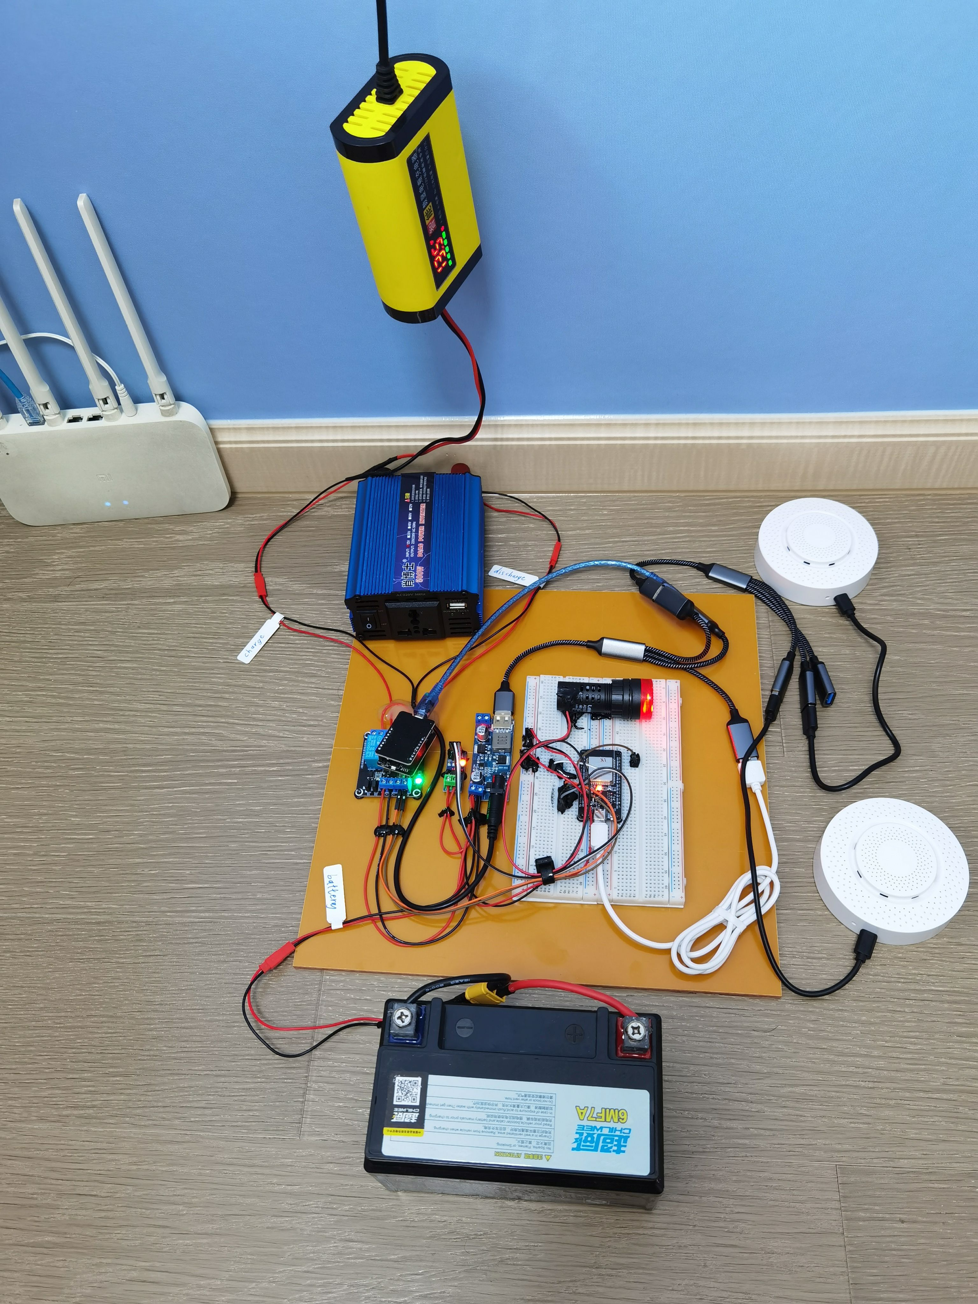
Energy Management System
Home Assistant
Micro
Inverter
4
Hybrid
BMS
Notes:
HomeGrid_Standardization_Initiative, 2024-08-28

Slide 6
Energy Management System
Home Assistant
Micro
Inverter
5
Home Automation Platform
Hybrid
BMS
Notes:
HomeGrid_Standardization_Initiative, 2024-08-28

Slide 7
Energy Management System
2
Home Assistant
Micro
Inverter
3
Home Automation Platform
1
4
Hybrid
BMS
Notes:
HomeGrid_Standardization_Initiative, 2024-08-28

